Slide 1
AIDS Clinical Trial Study
By: Nethra Ganesh, Catherine Byelousova, Anya (Andre) Chen, Sofia Canihuante

Slide 2
Table of contents
01
04
02
05
03
06
Introduction
Question 2
Dataset
Question 3
Question 1
Conclusion/Future Work

Slide 3
01
Introduction

Slide 4
Introduction
HIV-1 is present in 40.8 million people around the world today
Currently no cure for HIV → controlled through treatments to reduce the transmission and symptoms
Goal: Corroborate an important study in the history of HIV research to analyze various treatments and test their effectiveness to improve lives of those with HIV.
It is important to look at CD4 and CD8 levels when analyzing these treatments. A ratio of lower CD4 and higher CD8 levels results in a weakened immune system and worsening progression of the disease.
Notes:
Notes:
CD4 cells are T-helper cells that play an important role in the immune system and often decrease as the virus attacks the cells. CD8 cells are cytotoxic T cells that identify and destroy infected cells and often increase as they are trying to fight the disease.

Slide 5
02
Dataset

Slide 6
Dataset Overview
Dataset Description:
1995 double-blind clinical trial: 2467 patients, various HIV clinical trial units across the United States and Puerto Rico.
Tracks 23 total wellness and white blood cell metrics during the patients' stay, culminating in whether the patient passed away during the trials or not.
Critical Variables:
CD4 → baseline CD4 (cd40), ending CD4 (cd420), change in CD4 levels (cd4_change).
(positive delta = lost cd4)
CD8 → baseline CD8 (cd80), ending CD4 (cd820), change in CD4 levels (cd8_change).
trt → treatment group: 0 = Zidovudine (ZDV) only; 1 = ZDV + Didanosine (ddl); 2 = ZDV + Zalcitabine (Zal); 3 = ddl only (Categorical)
ZDV was the most prevalent antiretroviral medication at this time
cid → patient fate: 1 = Death/AIDS/other end point; 0 = No Death (Categorical)
Baseline conditions → e.g. age, weight kilograms (wtkg), homosexual activity (homo)
Prior treatment → e.g. had prior ZDV treatment (zprior)
Notes:
Notes
ZDV was the most prevalent antiretroviral medication at this time
1 is considered the “end point” but death is the primary one
Increasing CD8 cell counts might actually be bad if you don't have enough CD4 to cope w/ it

Slide 7
03
Question 1
What factors are the best predictors of "failure" (death, AIDS, or critical CD4 threshold) for patients in this trial?

Slide 8
Methods
Exploratory Data Analysis to Visualize Predictors
Histograms for CD4 and CD8 levels
Boxplots for Death Status based on Patient’s CD4 & CD8 levels
Random Forest Model with Confusion Matrix
General Logistic Model with AUC Value
Determines significant predictors for the death status of patients
LASSO Logistic Regression with ROC/AUC
Helpful for determining a smaller subset of predictors that are considered important
Notes:
To analyze this question, we first did an exploratory data analysis to visualize the predictors: we ran histograms to look at cd4 and cd8 levels as well as boxplots to look at death status based on a patient’s cd4 and cd8 levels. We then ran a random forest model with a confusion matrix. We used a general logistic model with a auc value to determine the significant predictors for death status of patients as well as a lasso logistic regression which is helpful for determining if there a smaller subset of predictors that are more important.

Slide 9
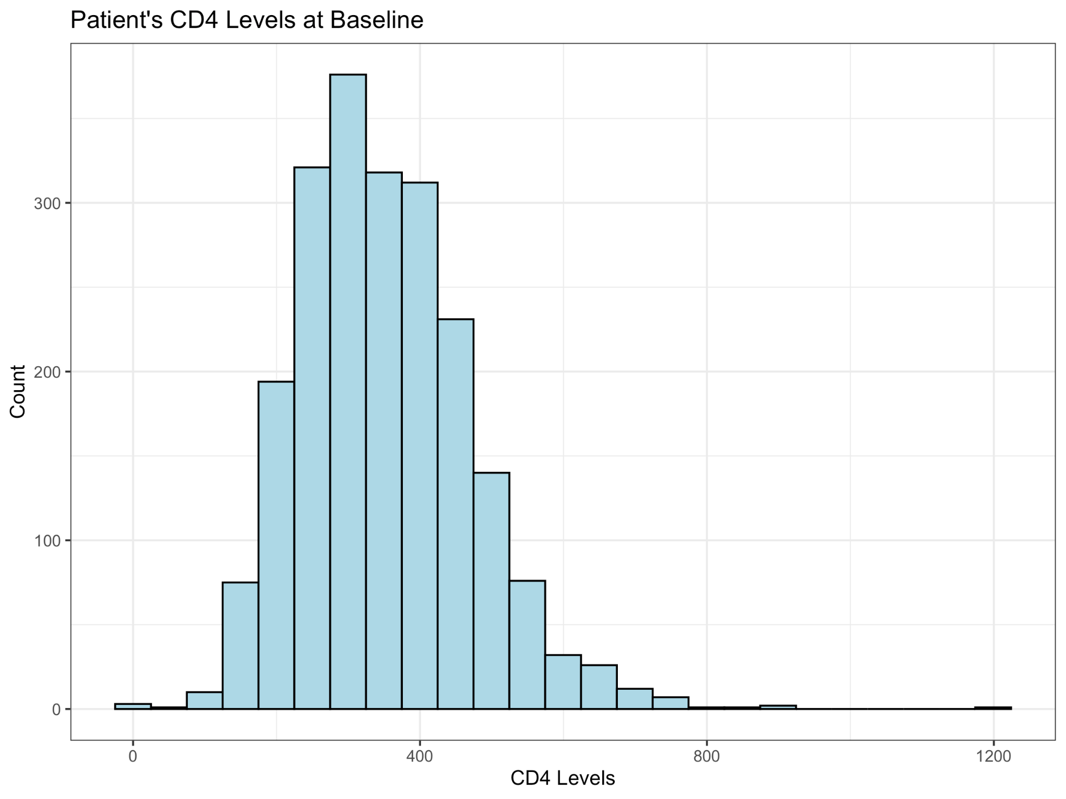
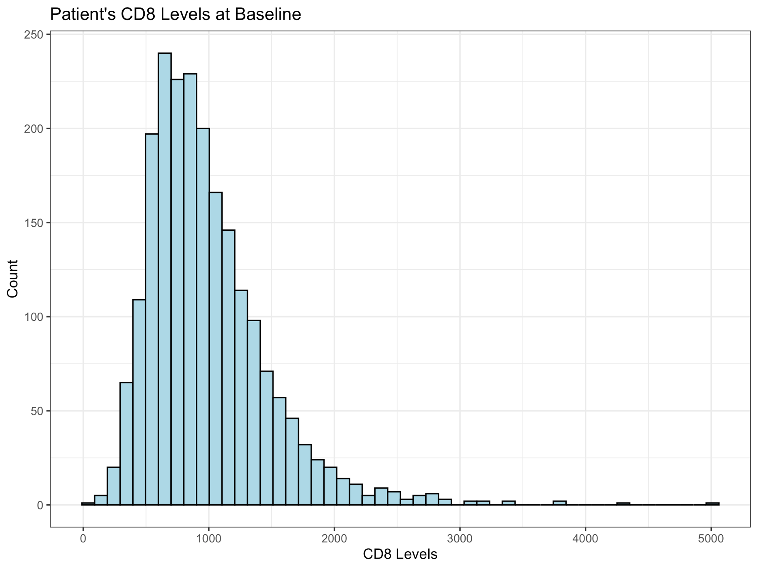
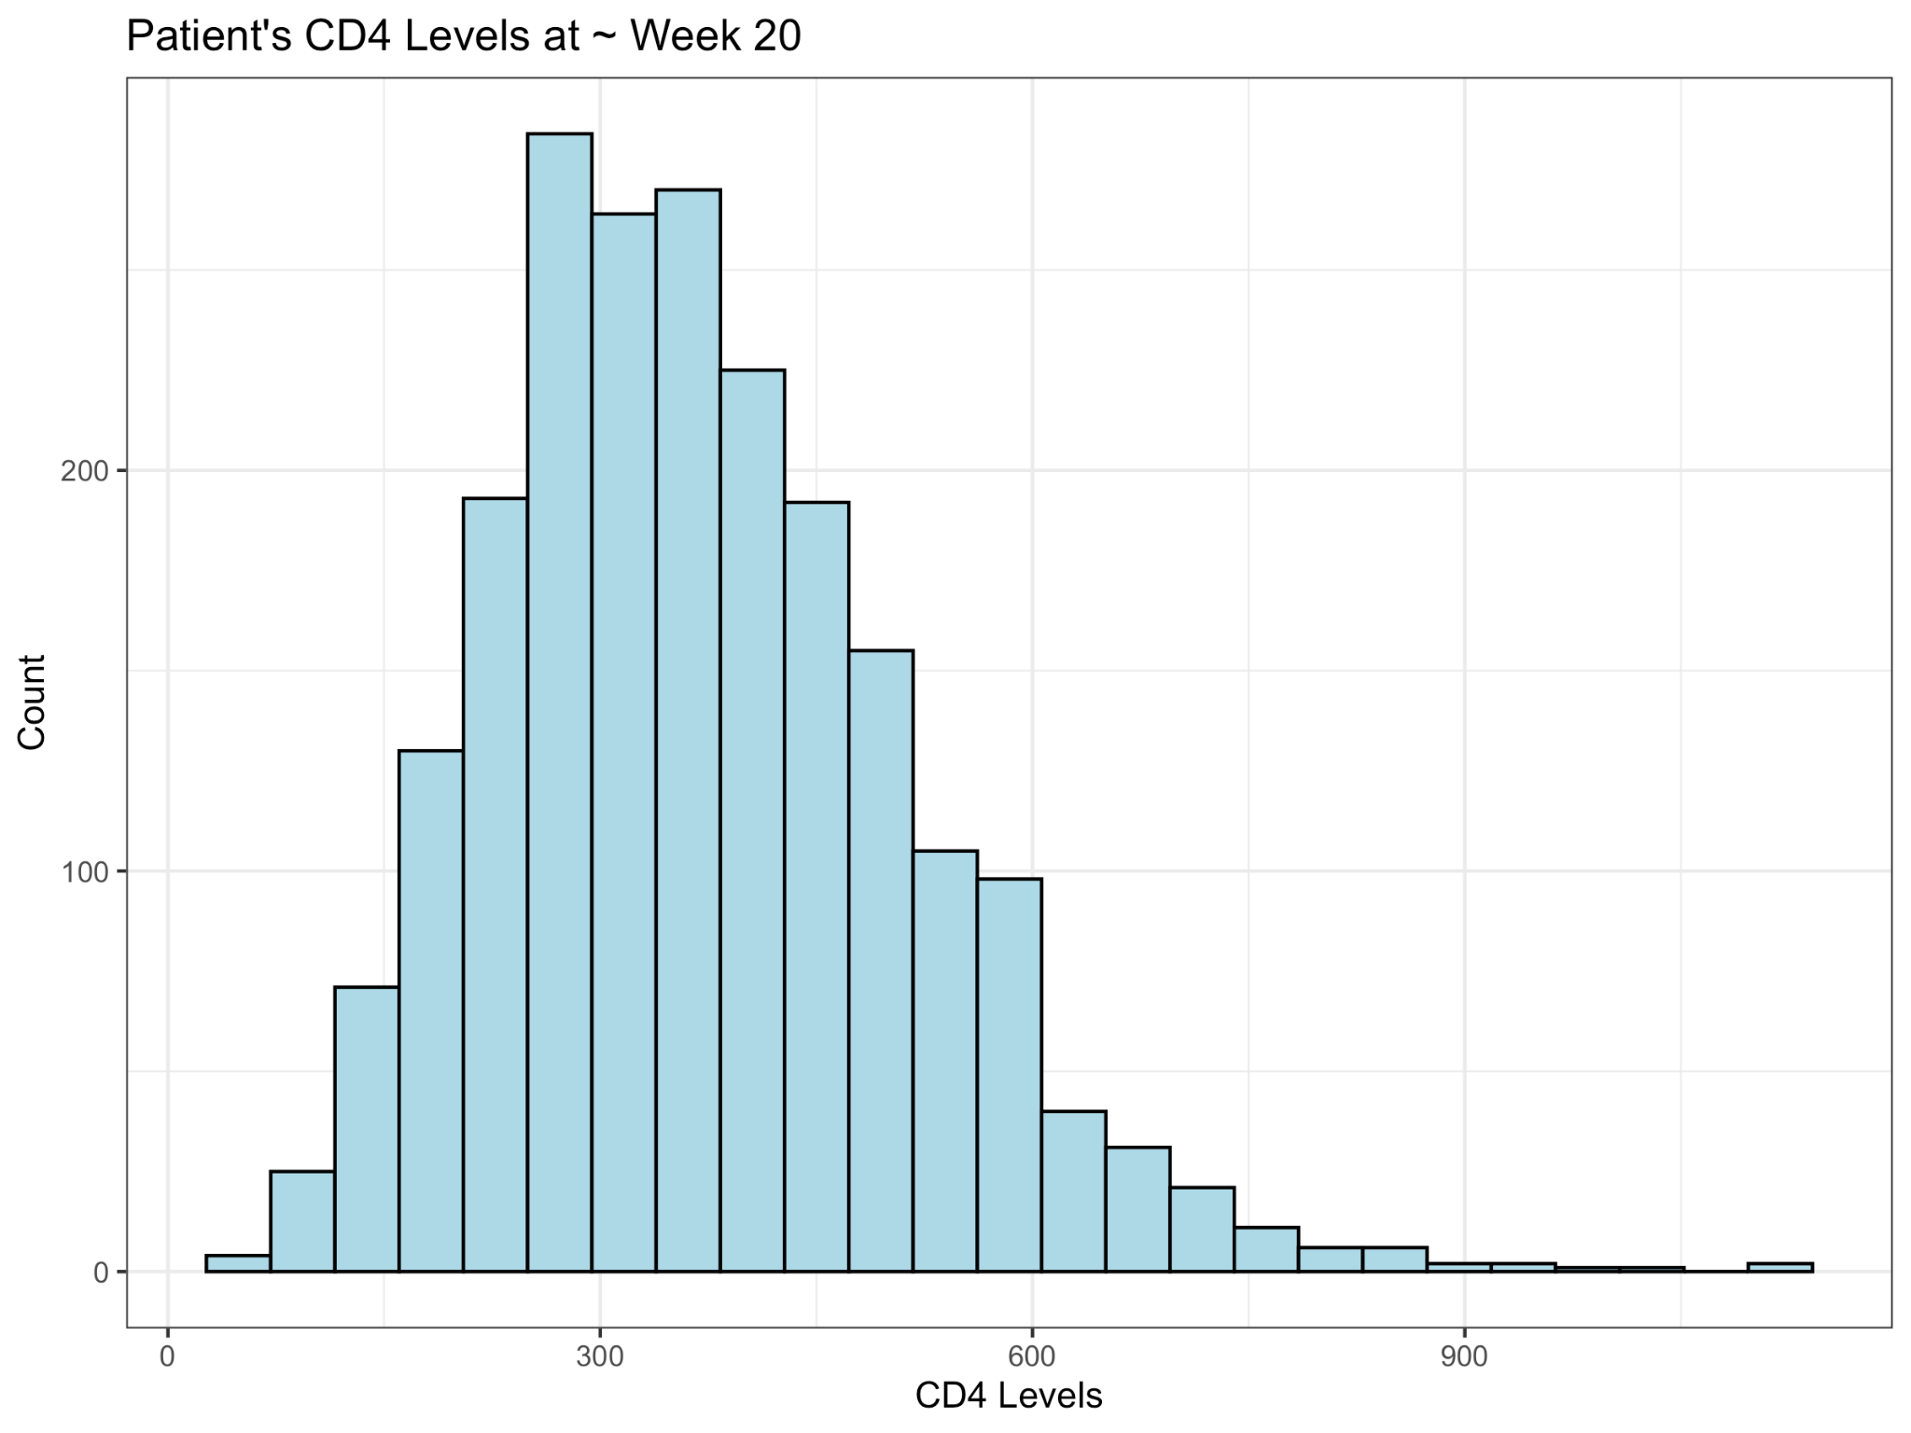
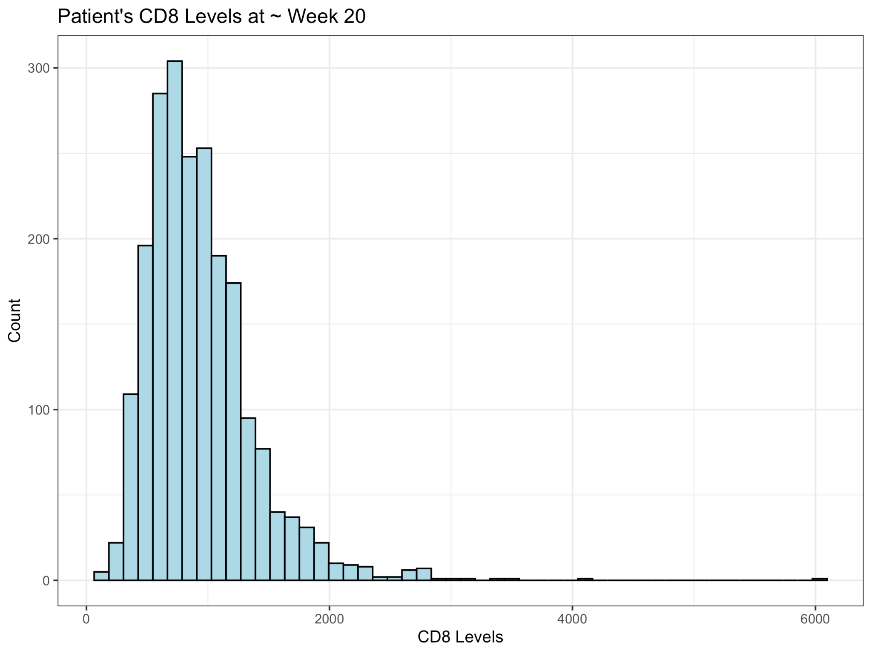
Exploratory Data Analysis
We find a slight left skew, especially with some outliers on the CD8 levels, but determined this is reasonable and workable.
CD4 Baseline
CD8 Baseline
CD4
Week 20
CD8
Week 20
Notes:
Through histograms, we analyzed the base spread of the initial CD4/CD8 levels and CD4/CD8 levels at week 20.
Here we have the histograms for cd4 and cd8 levels at baseline and week 20. As you can see, the graphs are slightly skewed left. There are outliers present esp with cd8 levels at baseline, however we chose to keep these data points in our analysis as we thought it would be relevant to our dataset.

Slide 10
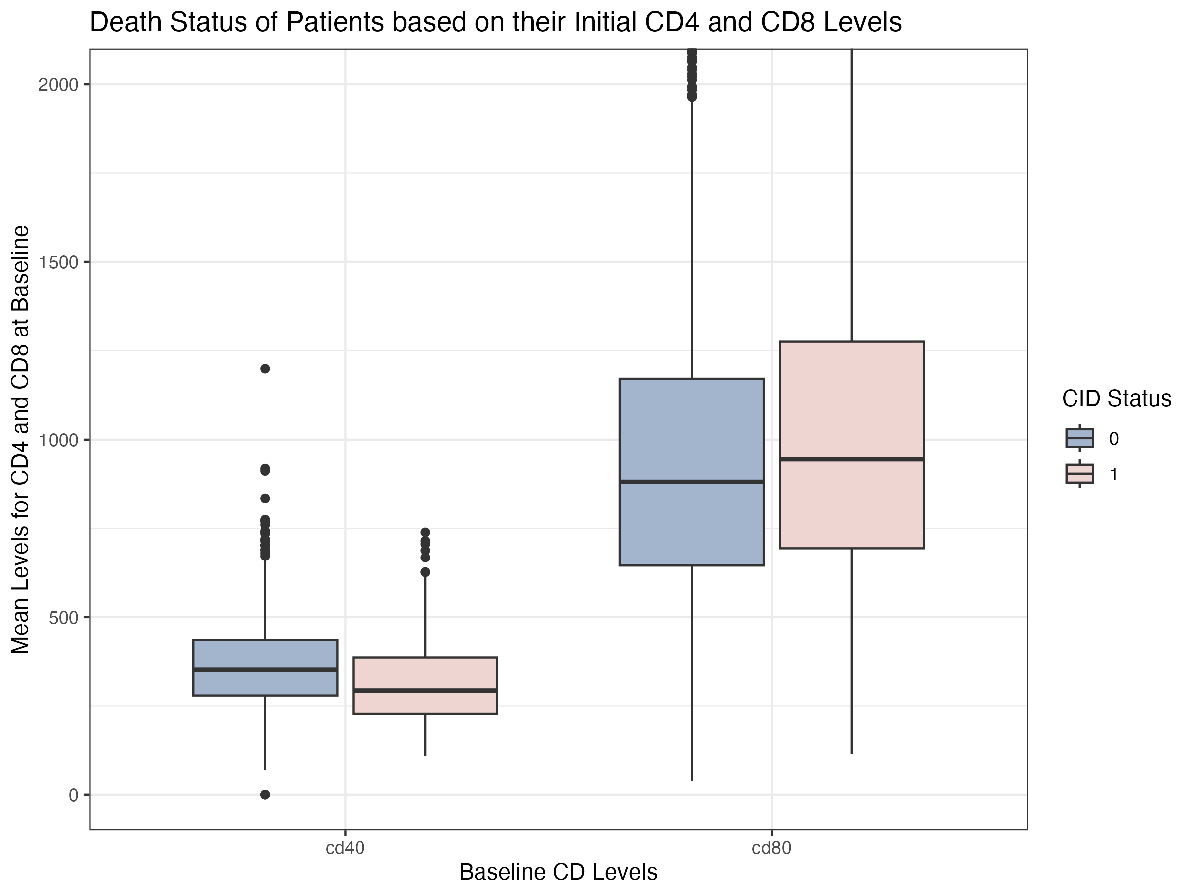
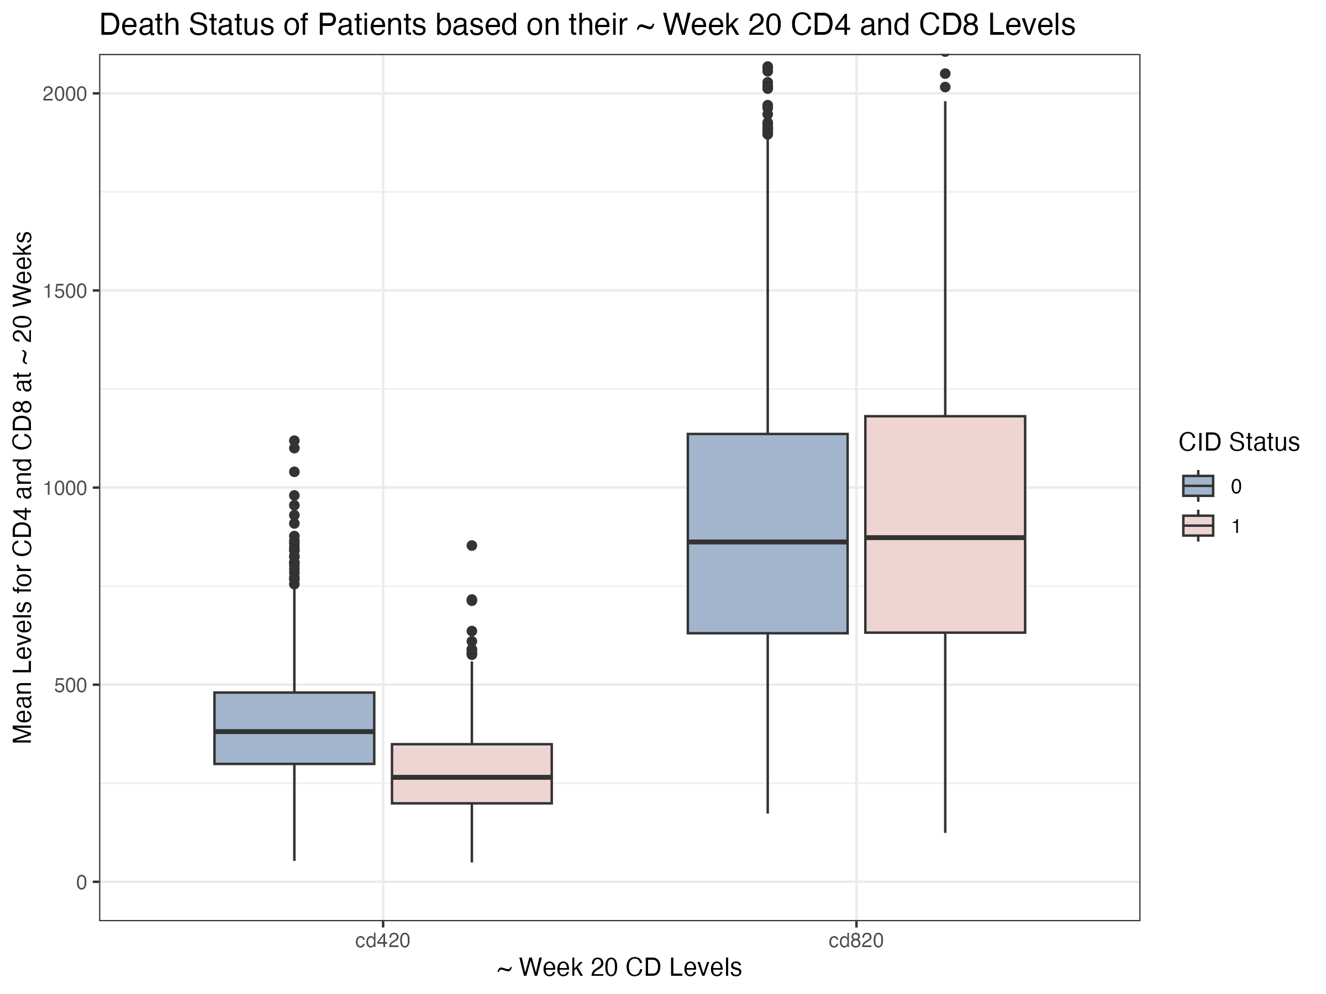
Exploratory Data Analysis
Boxplots of baseline/week 20 CD4/CD8 levels, on whether the patient passed away (in red) or did not (in blue) were produced.
Notes:
These boxplots show the base and week 20 cd4 and cd8 levels for patients who died, indicated in red, and for patients who lived, indicated in blue. For patients who died, the median cd4 levels slightly decreased while the median cd8 levels also decreased. For patients who lived, the median cd4 levels slightly increased while the median cd8 levels stayed approximately the same.

Slide 11
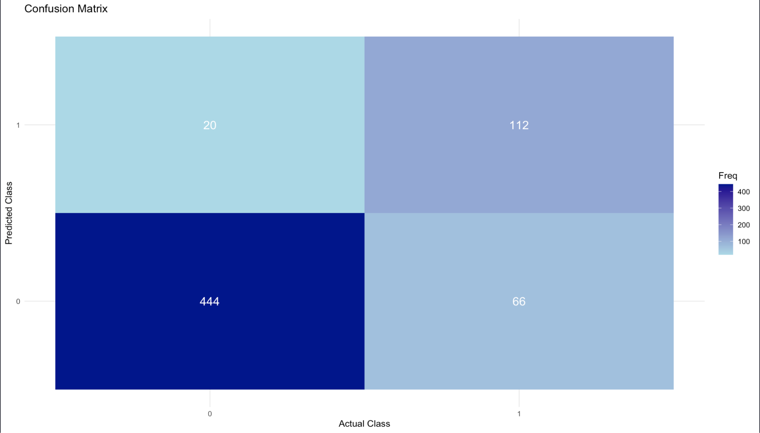
Random Forest Model
Results of the Confusion Matrix
True positive = 112
True negative = 444
False positive = 20
False negative = 66
Precision = 0.8485
Recall = 0.6292
F1 Score = 0.7226
Notes:
This is the confusion matrix for our random forest model. The results show that there is a precision of 84.85% and a recall of 62.92%. The high precision score indicates that when a model predicts death for a patient, it is highly accurate. However the moderate recall value indicates a higher rate of false negatives indicating that the model isn’t able to always accurately predict whether a patient died or not.
**recall measures of the ones that are actually true how many did you to predict to be true
**precision measures of the ones you predicted to be true how many are actually true

Slide 12
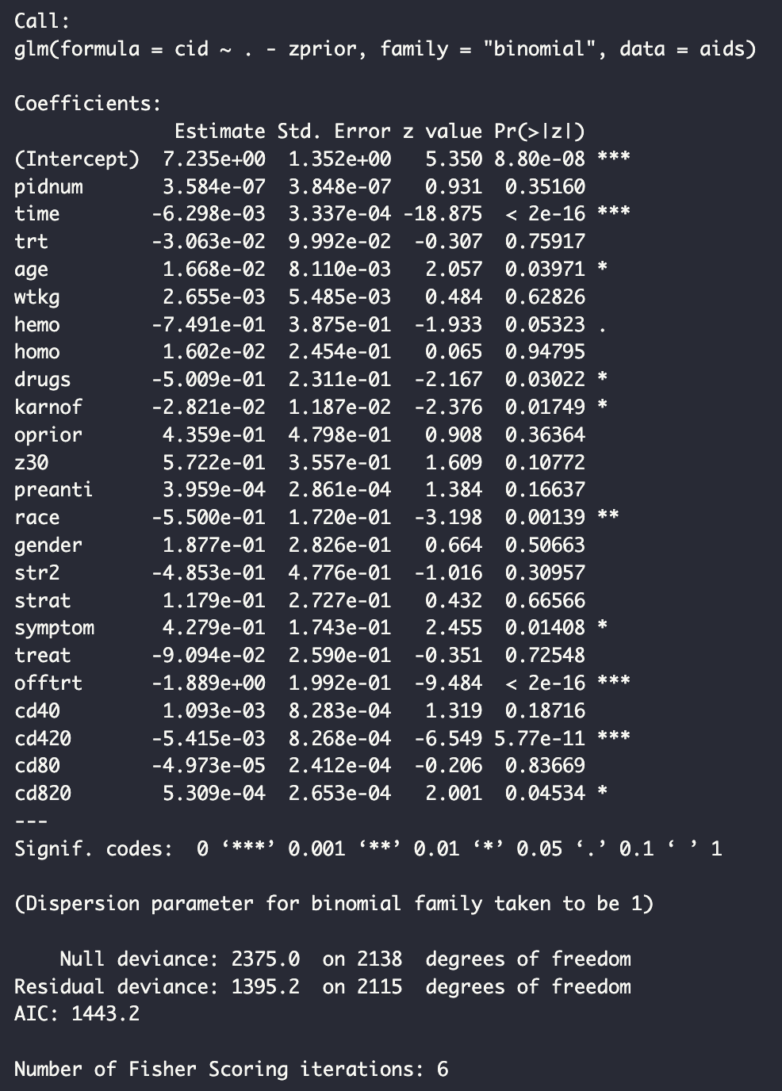
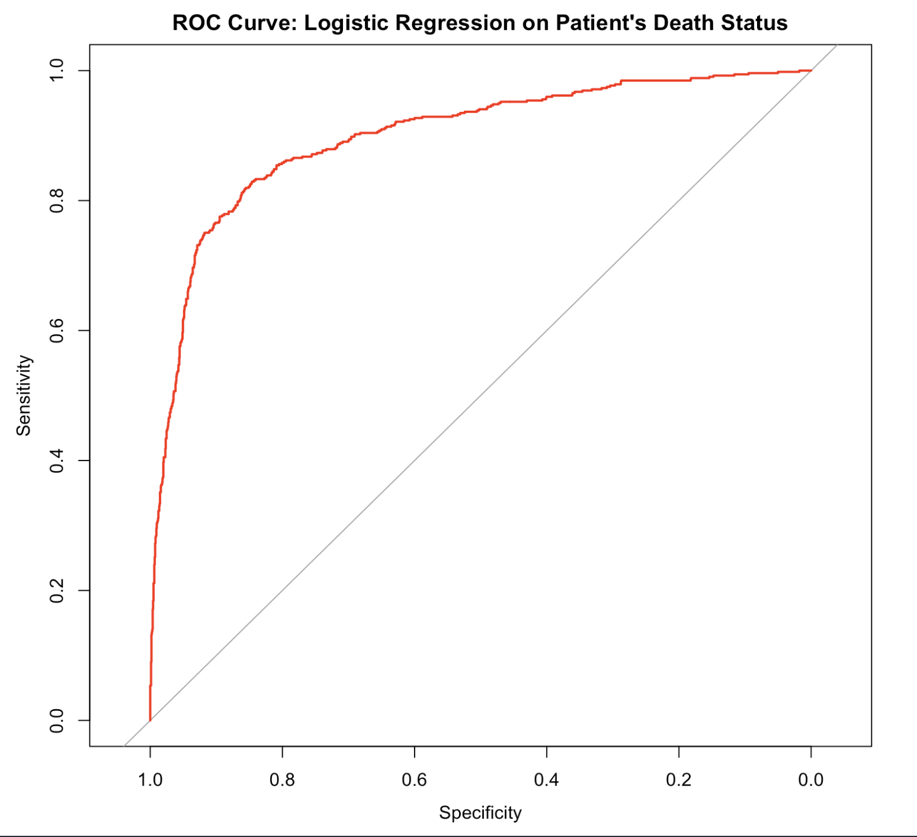
Logistic Model
AUC value of 0.89.
glm(formula = cid ~ . - zprior, family = "binomial", data = aids),
Notes:
We ran a logistic regression model as well as plotted the ROC curve and calculated the AUC value. The logistic regression summary showed multiple variables that exhibited significant relationships with death status, including time, age, drug use, Karnofsky score, race, whether a patient is symptomatic or asymptomatic, whether the patient was on or off testosterone before the trial, CD4 levels at week 20, and CD8 levels at week 20. The ROC curve hugs the top-left corner of the graph, which indicates high sensitivity (True Positive Rate) and high specificity (low False Positive Rate), so the model has good predictive ability. High AUC Value indicates strong distinguishing ability → ability to differentiate between patients who died vs survived, highlighting that the model is able to identify significant predictors of death

Slide 13
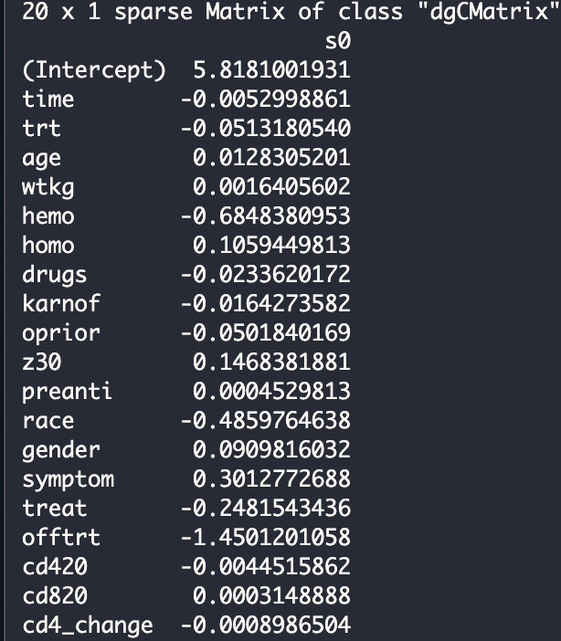
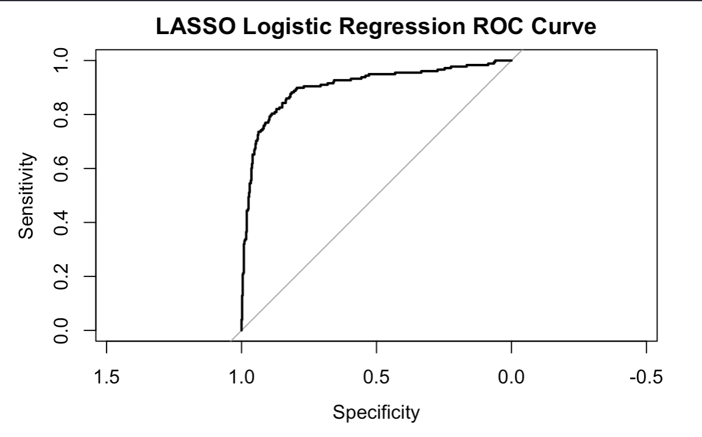
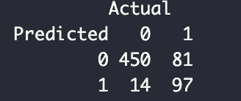
LASSO Logistic Regression
An ROC curve was produced with an AUC value of 0.90.
Notes:
Due to the size of the dataset and results from our logistic regression, a LASSO logistic regression was performed in hopes of narrowing down a smaller subset of predictors that are considered “important” or significant when predicting the death status of patients. Cross-validation was performed beforehand to determine the best tuning parameter (lambda) for the regression, which was determined to be 0.003261376. This value is very small and indicates a complex model where many variables were kept, which can be seen in the output of the regression summary. Variables such as age, symptomatic status, and race increased the risk of death, while variables like hemophilia status, treatment type, and being off testosterone seemed to lower the risk. The model had an accuracy of 85.2% with an AUC 0.90, demonstrating its ability to successfully predict the death status of patients.

Slide 14
Conclusions for Data Analysis
Confusion matrix indicates high precision and moderate recall scores
could impact treatment plans due to higher false negatives
Logistic model and LASSO regression model both have high AUC values → good at predicting death status based on several predictor variables
Notable variables for predicting death status: age, symptomatic status, race, whether the patient was on or off testosterone before the trial
Notes:
To summarize everything, the confusion matrix showed a high precision and moderate recall scores. The higher rate of false negative could impact treatment plans for these patients as they are at a higher risk of death than what the model predicts. Both the logistic and LASSO regression model have higher AUC values which means the are good at predicting death status based on several variables predictors. Some notable variables for predicting death status based on these models include age, symptomatic status, race, and whether a patient was on or off testosterone before the trial.

Slide 15
04
Question 2
Do patients experience a slower or faster progression depending on baseline variables or different factors?
Notes:
The second question that we wanted to answer was determining whether patients experienced a slower or faster progression depending on baseline variables such as their age, gender, etc. or other factors such as whether the patient received antiretroviral treatment
The progression of HIV was determined by tracking changes in CD4 and CD8 cell counts, which was calculated by taking the difference in baseline and week 20 measurements.

Slide 16
Methods
Linear regression with Diagnostic plots
Determining significant predictors for the progression of HIV, or the change in baseline CD4 and CD8 levels
Generalized Additive Model with Diagnostic Plots
Builds a non-linear model for several predictors while maintaining the additivity and “smoothing” numerical predictors
Random Forest Regression
Handles large datasets with complex, non-linear relationships by averaging the results of several decision trees.

Slide 17
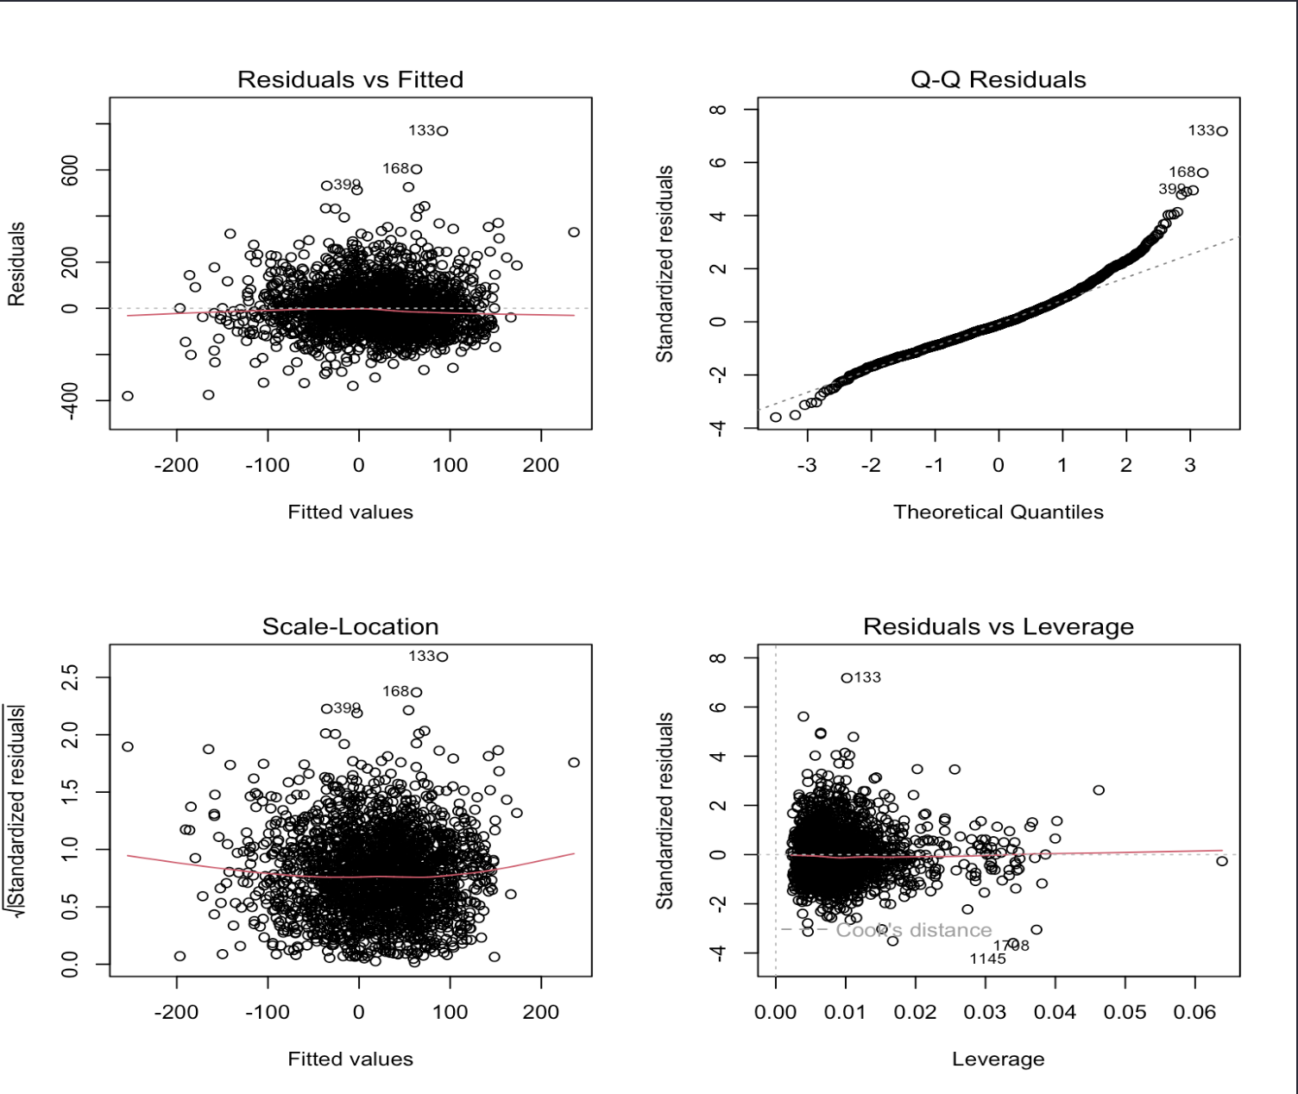
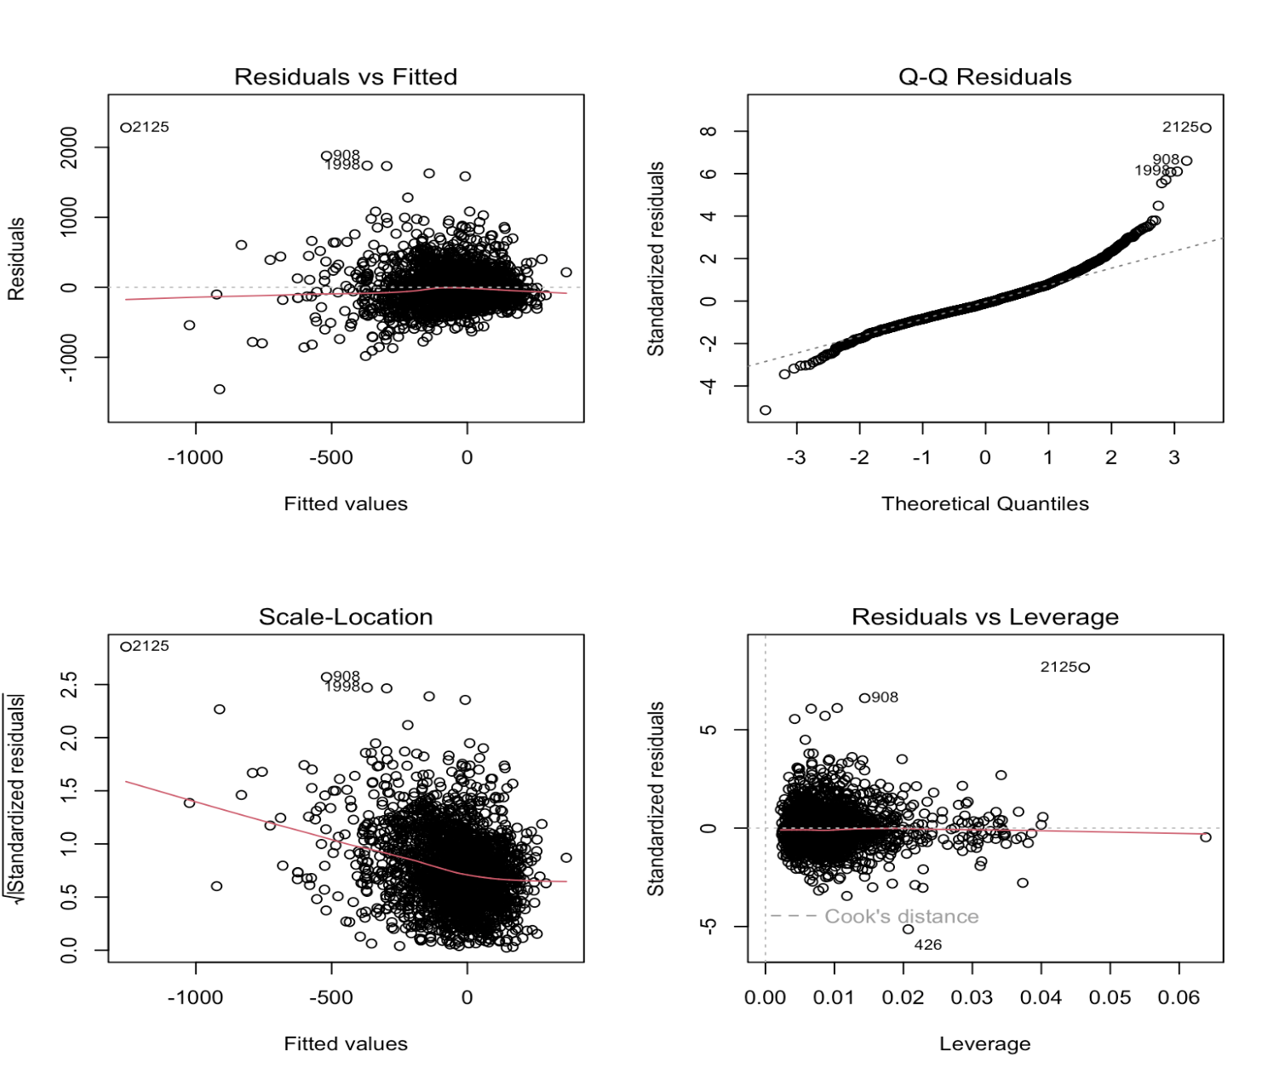
Linear Regression
Notes:
The significant predictors for CD4 level changes included the time to death (time), the treatment received (trt), the hemophilia status (hemo), previous drug therapy for AIDS outside of ZDV (oprior), the patient’s race (race), and baseline CD4 and CD8 levels (cd40/cd80). We find some significant predictors for the change in CD8 levels, including time to death (time), the hemophilia status (hemo), previous drug or antiretroviral therapy (z30, oprior, str2), and baseline CD4 and CD8 levels (cd40/cd80). The adjusted R^2 was around 23% for both models, which indicates the models failed to explain a large portion of variability in those levels. Although the regression summaries demonstrated significant results, the diagnostic plots revealed issues with linearity and equal variance, prompting us to work with non-linear models to more accurately demonstrate significant relationships.

Slide 18
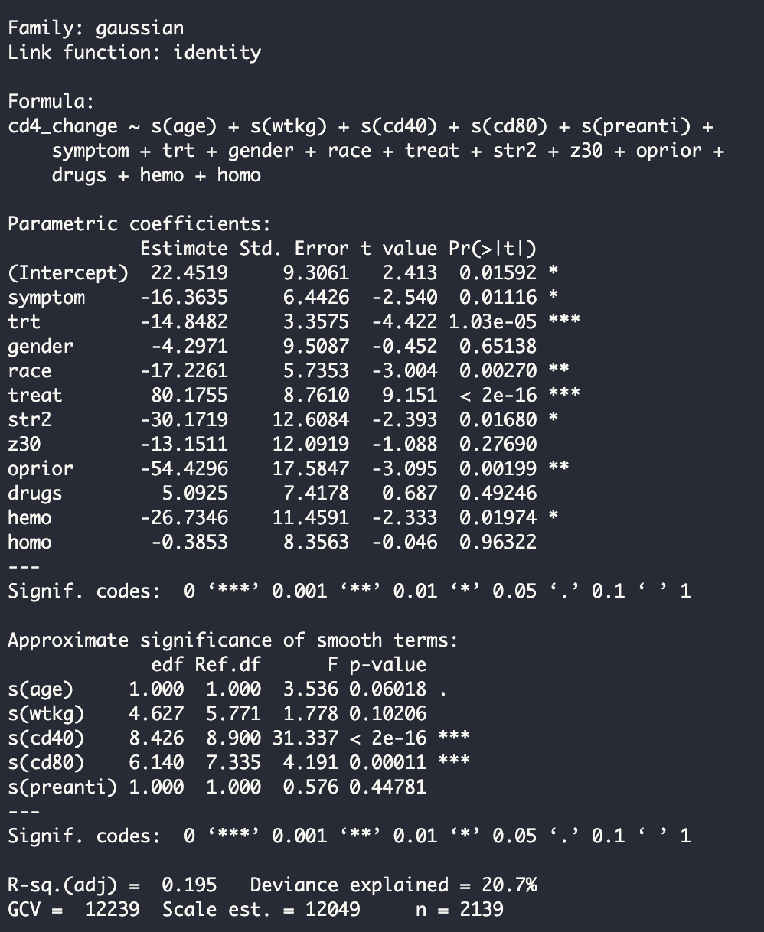
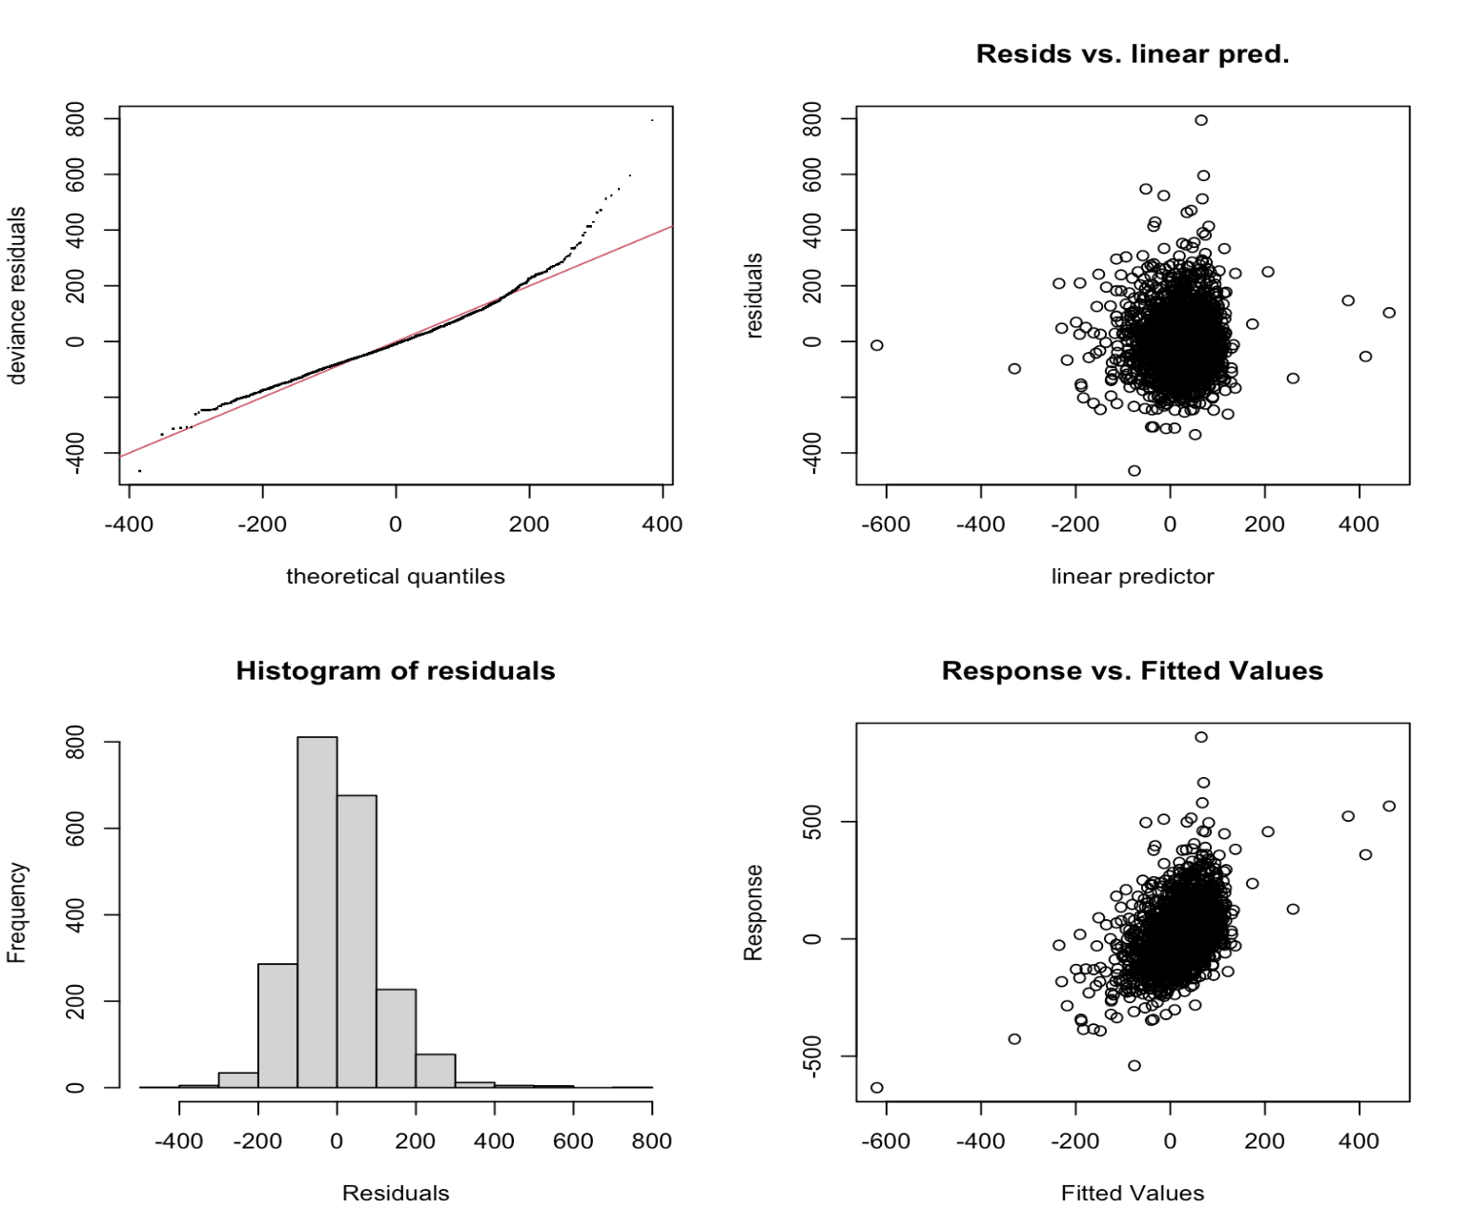
Generalized Additive Model
Notes:
We used a generalized additive model (GAM) to build a non-linear model capable of smoothing non-linear variables, considering the result of the linear regression. The GAM recognized several significant variables, both categorical and numerical. The categorical variables that proved to be significant predictors include trt, race, treat, oprior, hemo, and symptom. Baseline CD4 and CD8 levels, the numeric variables, demonstrated significant nonlinear effects, but the model itself had an adjusted R^2 of 19.5%, which is fairly low. Although the model was not able to explain most of the deviance, it converged successfully and identified several significant variables without smoothness problems.

Slide 19
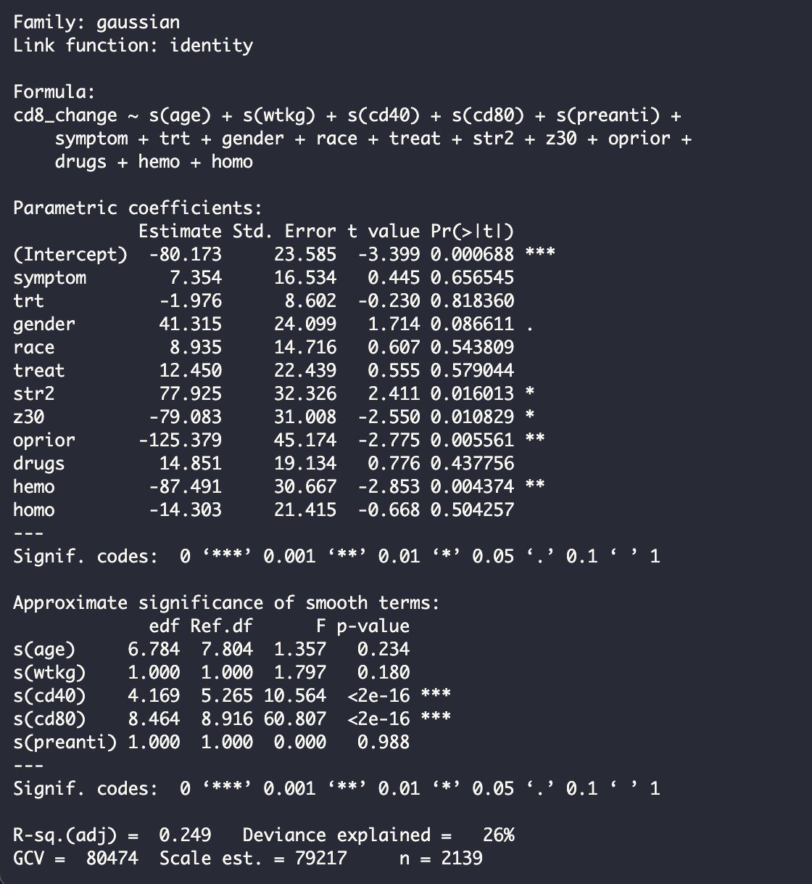
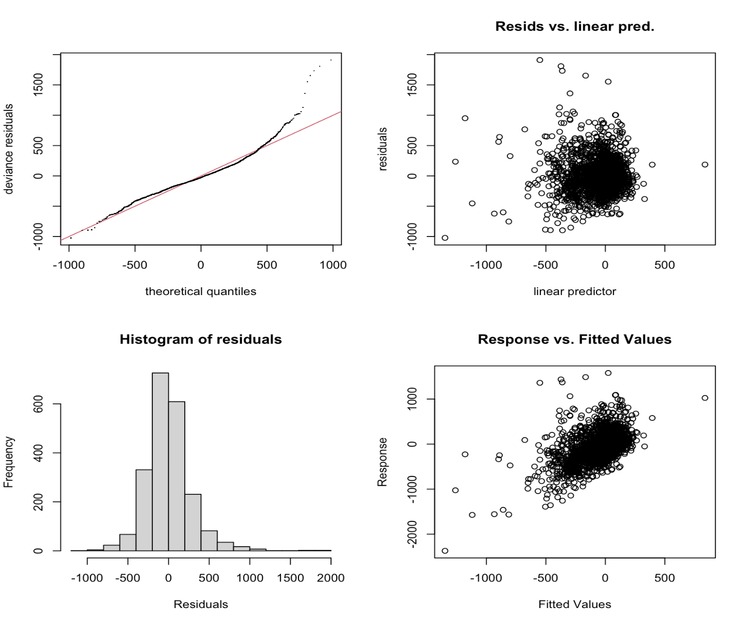
Generalized Additive Model
Notes:
The generalized additive model (GAM) was also conducted for changes in CD8 levels. The model had an adjusted R^2 of 25% and explained 26% of the deviance, which is an improvement from the previous model for CD4 level changes, but still very low. Similarly to the last problem, the model converged successfully and identified significant predictors. The categorical predictors include if the patient received any antiretroviral treatments for HIV prior to the study (str2), whether the patient had ZDV in the 30 days before study start (z30), if the patient had previously undergone drug therapy for their AIDS outside of ZDV (oprior), and whether the patient had hemophilia (hemo) (different from CD4 predictors). Baseline CD4 and CD8 levels demonstrated highly significant nonlinear effects once again, exhibiting how baseline levels are crucial in terms of HIV progression.

Slide 20
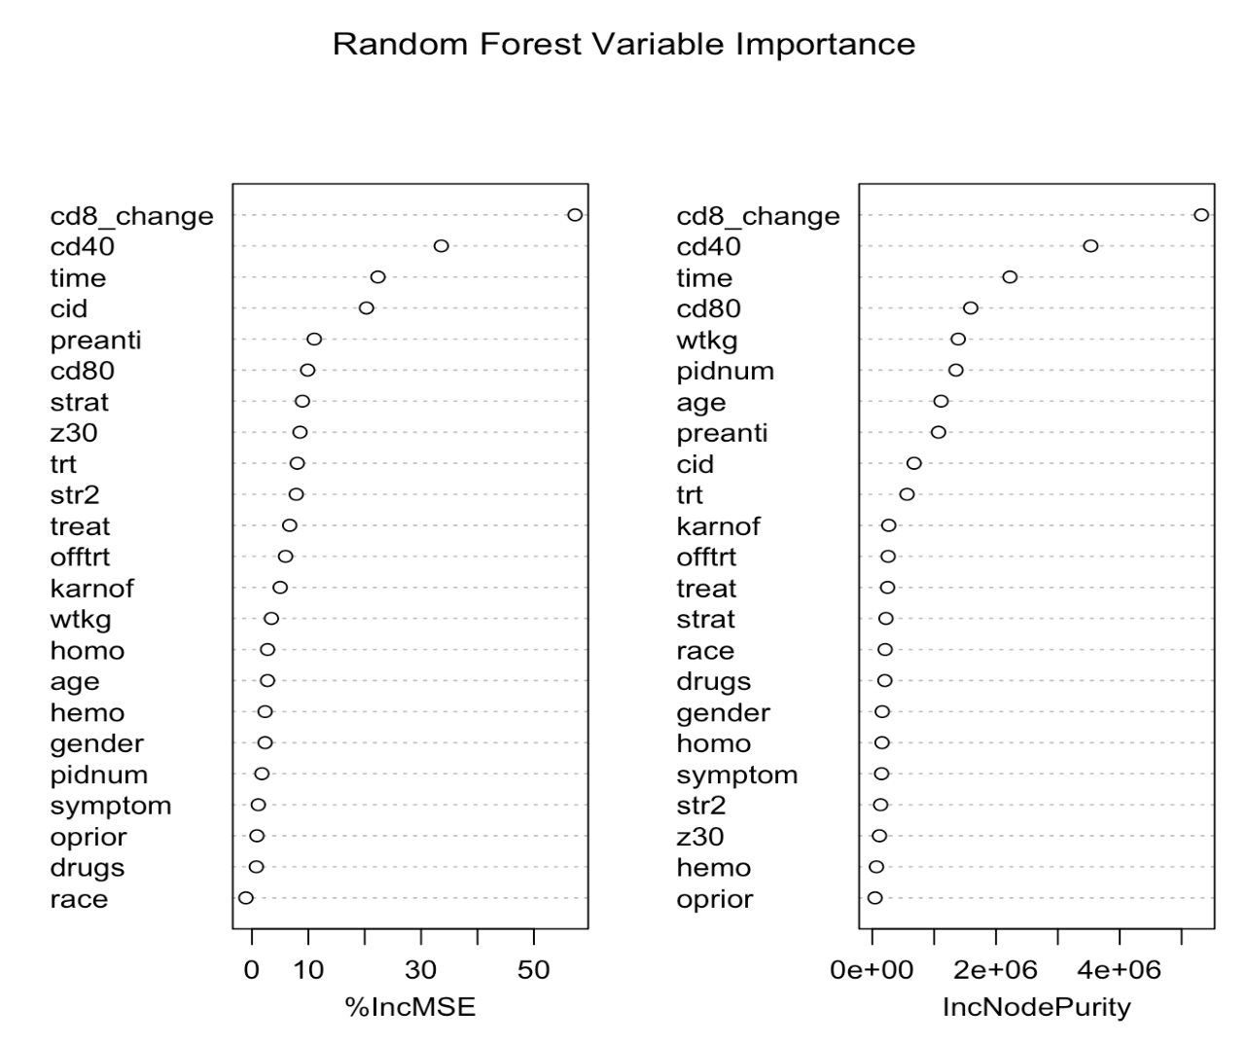
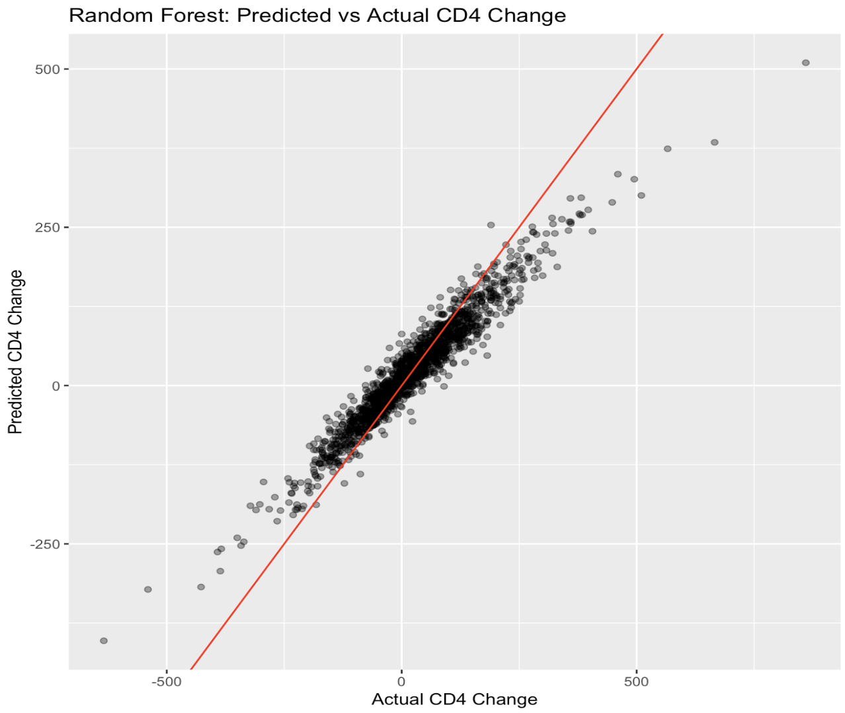
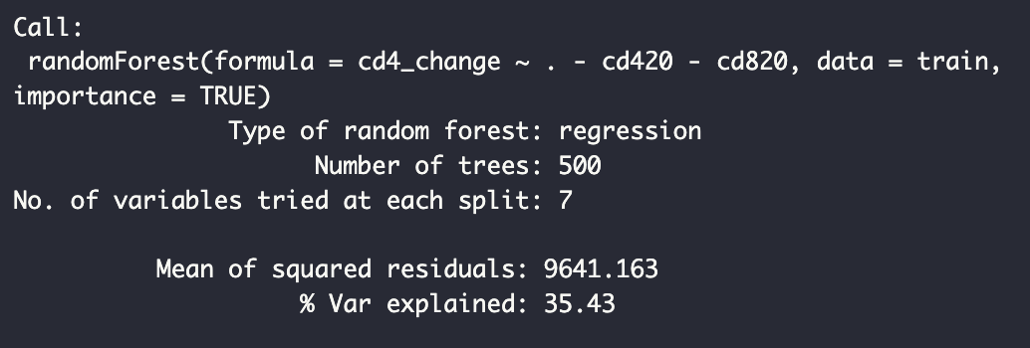
Random Forest Regression
Notes:
Aside from running a generalized additive model, we also conducted random forest regression to predict changes in CD4 and CD8 levels. Random forest models are able to work with rather complex data and average the predictions of several trees to reduce overfitting and improve accuracy. This model was able to explain 35.43% of the variance, which is reasonable for biological data that is fairly noisy. The model’s performance is fair, but does not provide much insight into the strongest predictors for HIV progression. The variable importance plots indicate that the most important variables are the baseline CD4 levels, the time to death, and the death status itself, which none of them provide insight into how previous treatment or baseline conditions (besides CD4 levels which is given) can affect a patient’s progression.

Slide 21
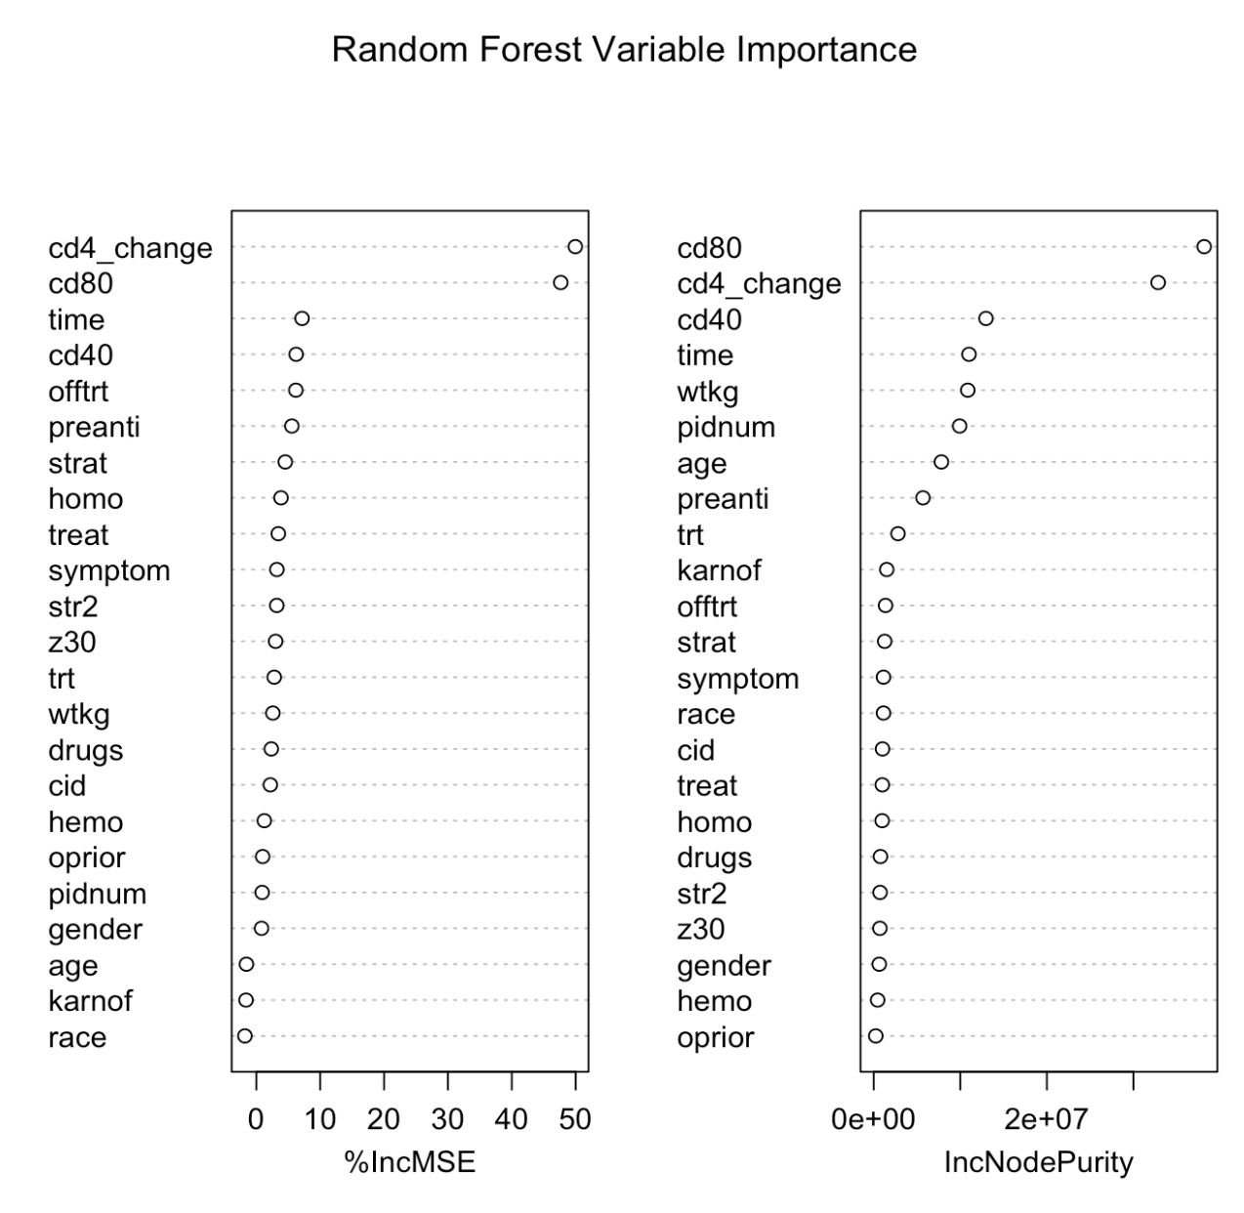
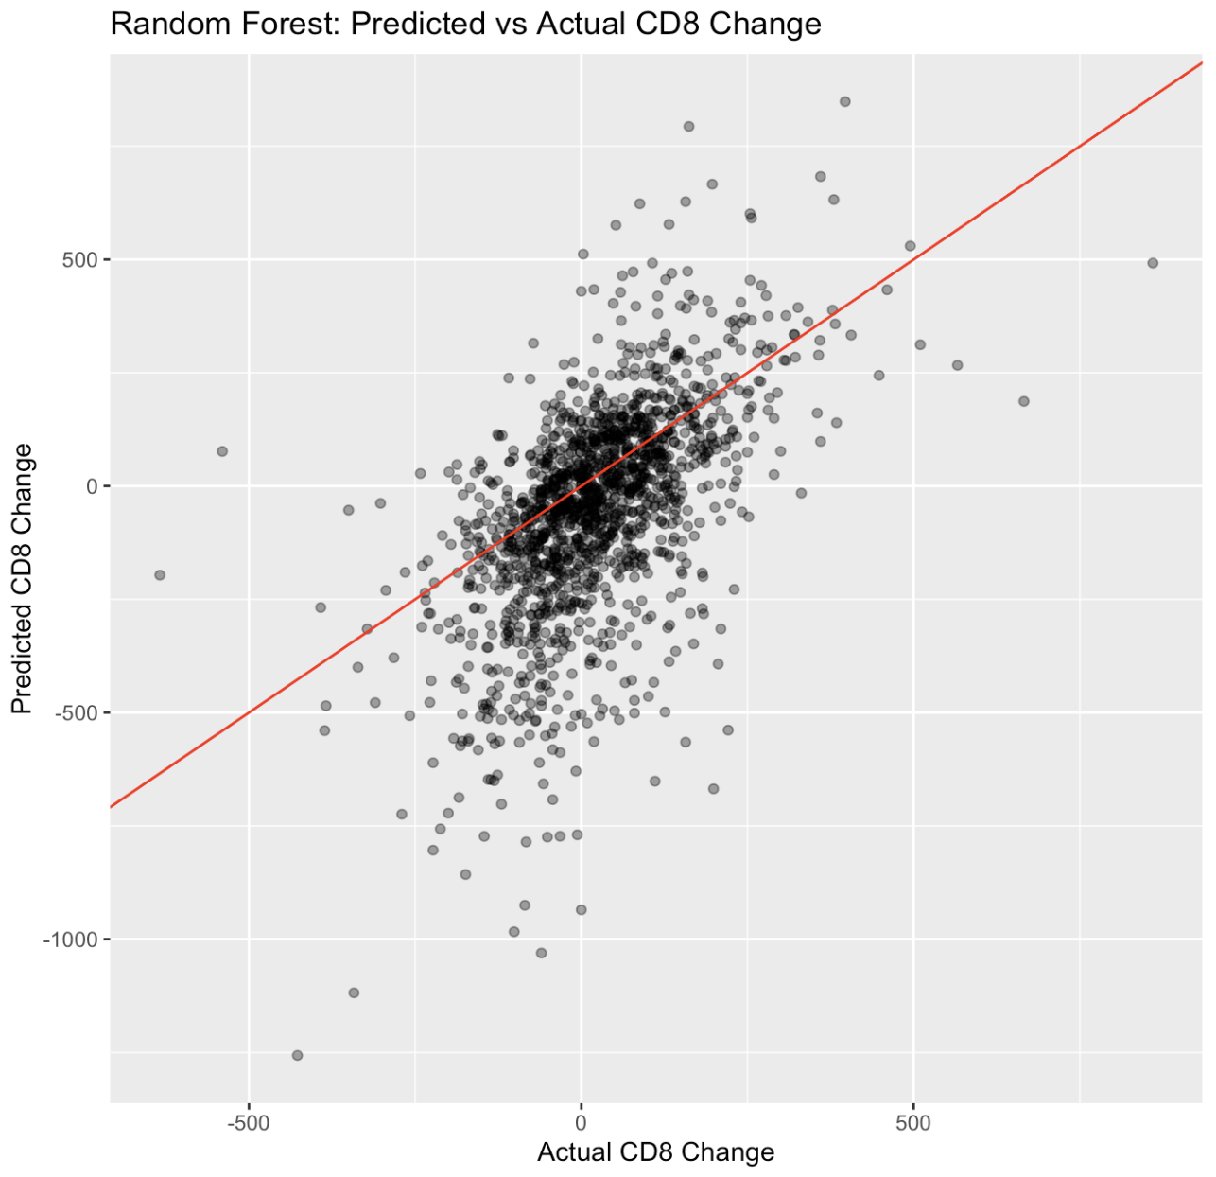
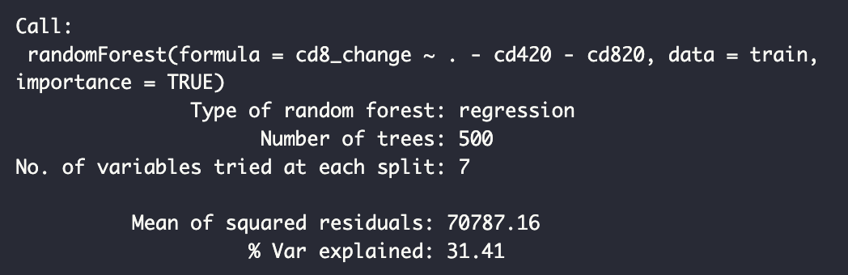
Random Forest Regression
Notes:
The random forest regression for the changes in CD8 levels produced a model that explained 31.41% of the variance. Similarly to the previous model for CD4 changes, the most important predictors include baseline CD8 and CD4 levels and time to death. Some variables such as weight, age, and previous retroviral treatment had non-zero results, but still were very low relative to the most important variables.

Slide 22
Conclusions for Data Analysis
Both the GAM and Random Forest Model identified several significant predictors, with the GAM identifying highly significant nonlinear effects with the numeric predictors
Results indicate that other predictors not included in the dataset have more significant effects on the progression of HIV
The dataset lacks temporal data, which resulted in us determining the progression by taking the difference in CD4 and CD8 levels
Notes:
Based on this data analysis, we conclude that the models did identify several significant predictors, with the GAM identifying highly significant non-linear effects. However, both of the models’ performances were weak and explained about 20 - 30% of the variance in the changes of CD4 and CD8 levels. These results indicate that other predictors outside of the dataset have more significant effects on the progression of HIV, such as unmeasured biological factors or dynamics within a patient’s viral system. Although baseline CD4 and CD8 levels were considered important in both models, the lack of temporal data led us to calculate the change in levels by utilizing baseline results, which likely explains their strong correlation.

Slide 23
05
Question 3
Are there subgroups of patients that would benefit more from a specific therapy?
Notes:
The original paper concluded that any of therapy regimens 1, 2, 3 were better than ZDV, but therapy 2 was effective only on treatment-naive patients. We wondered whether specific therapies might be more effective than others on other subgroups of patients.

Slide 24
Methods
Exploratory analysis
Boxplots
on week 20 CD4/CD8 levels, change thereof
Blind classification tree
on cid status
a) Identify subgroups; b) determine trt group efficacy
PCA (FAMD!) → hierarchical clustering
Basic box plot
Notes:
This one we took a while to decide on the methods, but we decided to do the following exploratory/initial analysis: first, boxplots to get an idea of the spread of data, then a classification tree to identify if there were any important splits from existing demographic/baseline attributes. Then, we did PCA to reduce number of variables and clustered hierarchically to obtain subgroups on more abstract factors, and did a basic box plot after that just to see roughly what therapy group might be best on each derived subgroup.

Slide 25
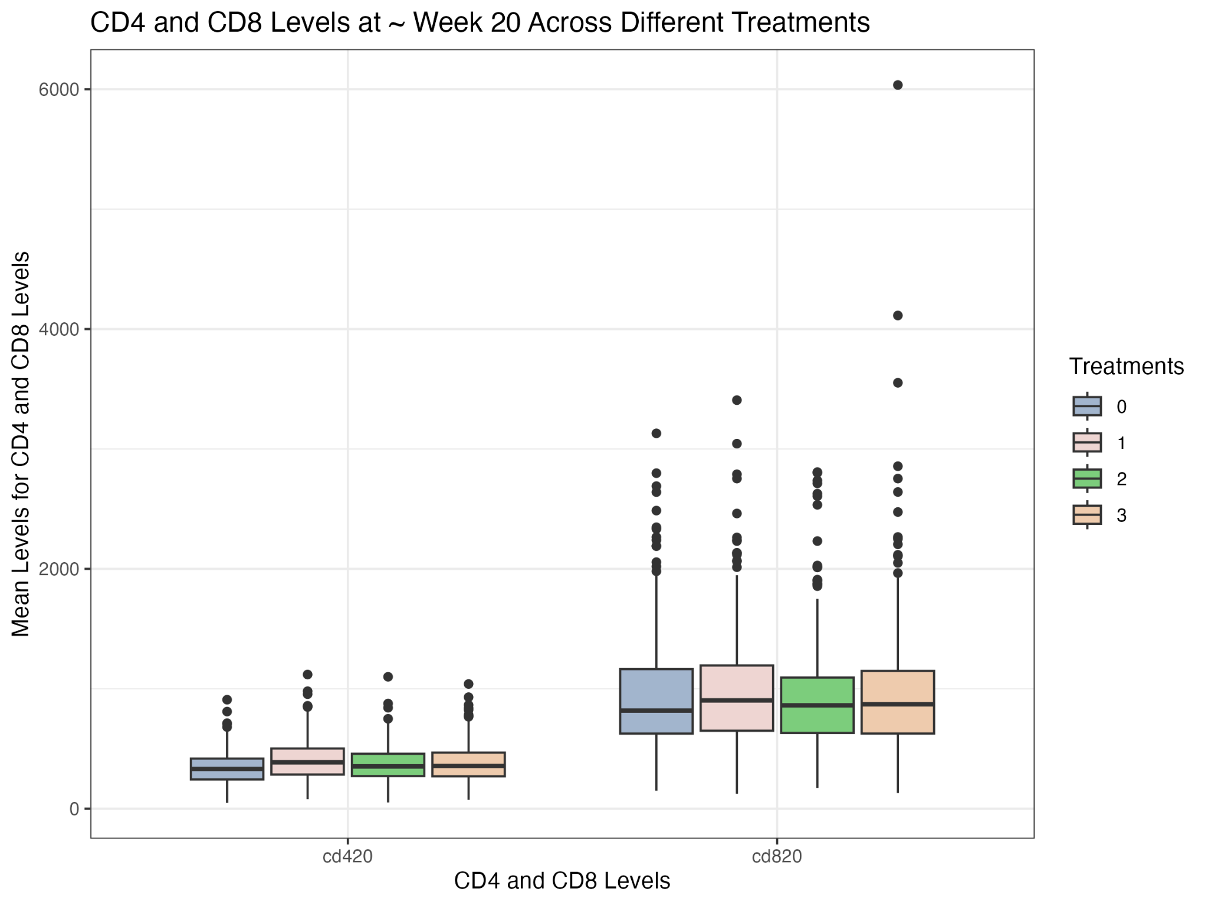
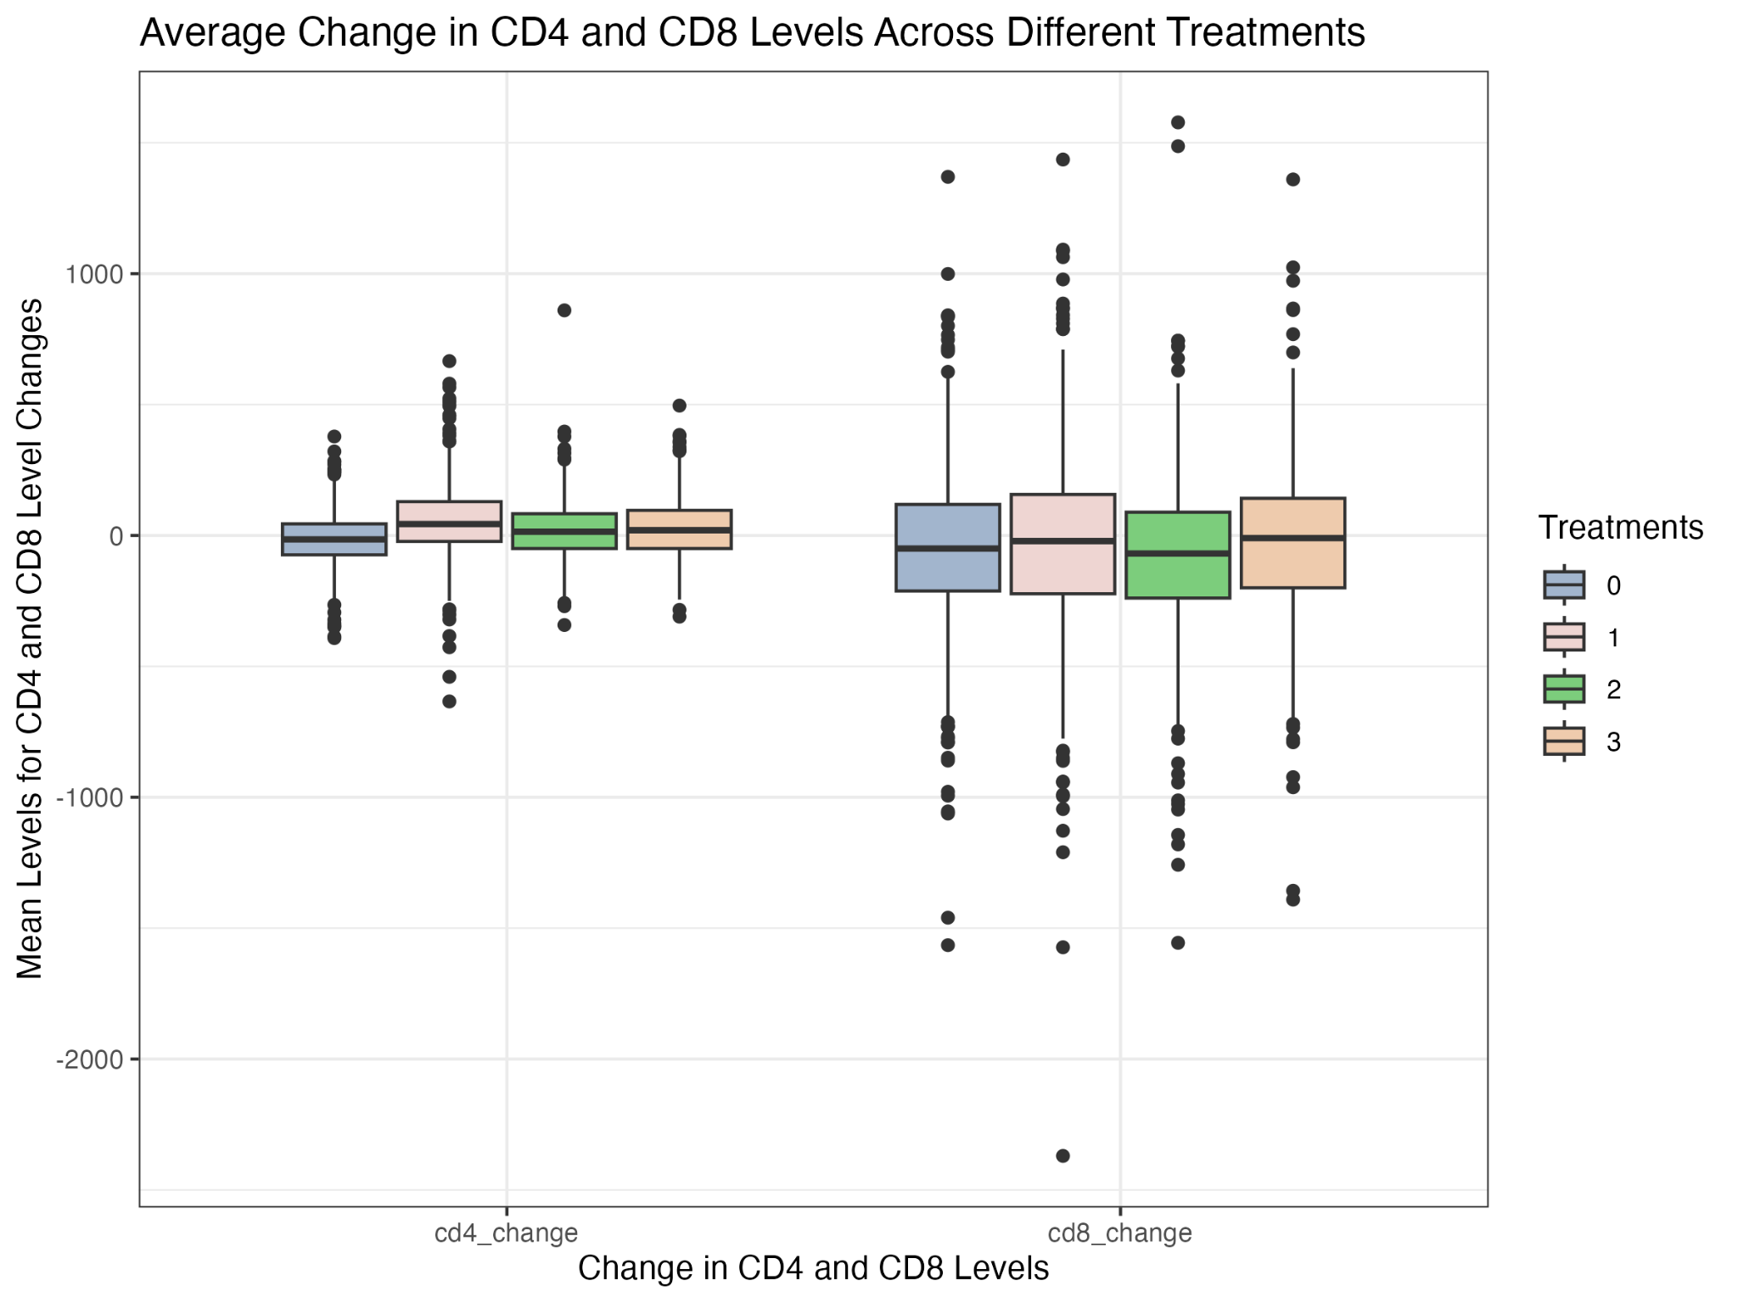
Overview: effect of trt (no subgroups) on CD4/CD8
Notes:
Firstly, we look at the CD4/CD8 at week 20 and delta CD4/CD8 across each treatment group. This graph is very zoomed out due to some notable outliers on the CD8 side; we ended up only using CD4_change as our final "effectiveness of treatment" metric for this question as it is most starting-state agnostic, and impactful in the worsening of HIV. In the interest of time, let's just look at that one in particular: see that treatment 0 (recall, ZDV, our status quo therapy regimen) performs slightly worse (this graph is flipped) than the other three, and treatment 1 is most effective on average across all patients.

Slide 26
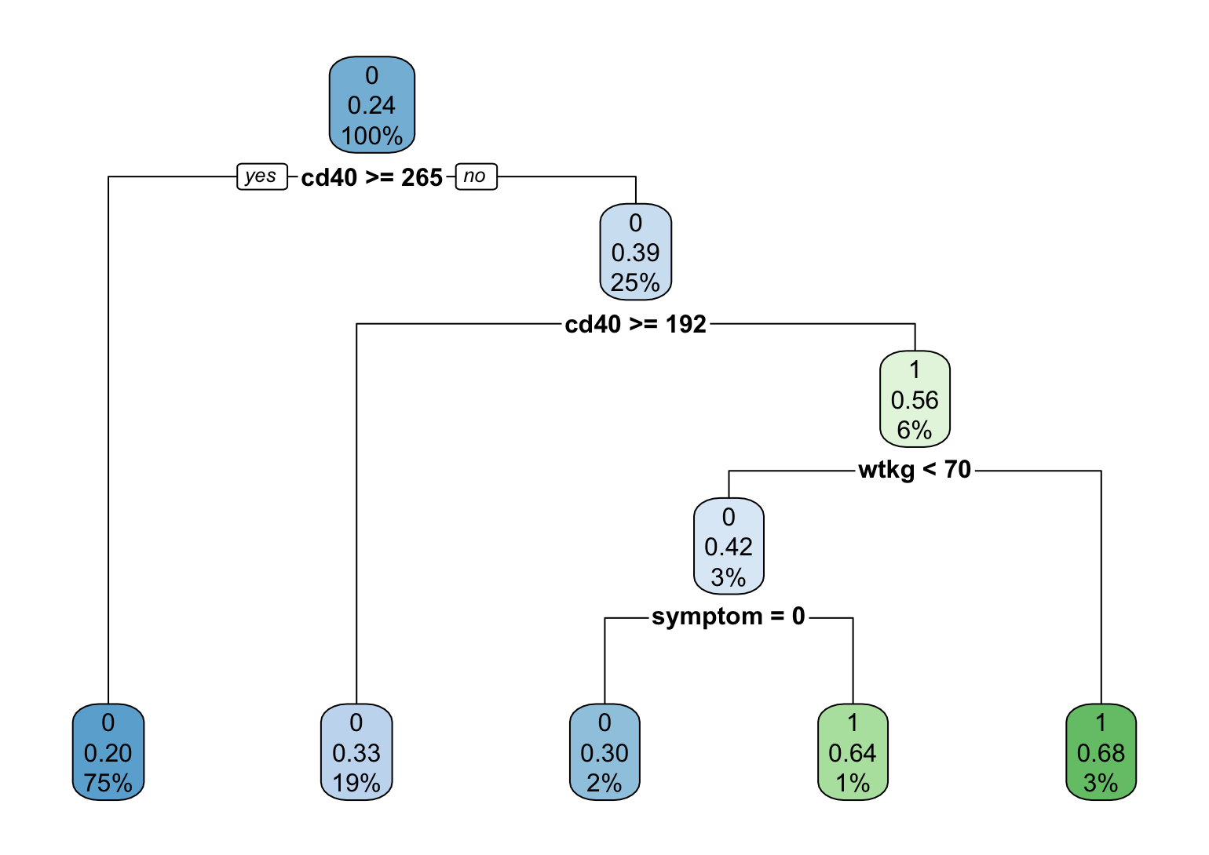
Classification Tree on CID
 | Truth=0 (no end point) | Truth=1 (end point)
Predicted=0 | 1587 | 457
Predicted=1 | 31 | 64
Accuracy: 0.7719
Recall: 0.9808
Precision: 0.7764
F1 score: 0.8667
Notes:
We then tried to determine which factors might be important in determining the effectiveness of ANY treatment; see this classification tree on CID. We selected a classification tree because it handles both categorical and numerical variables just fine. Overall, the tree is pretty basic and performs... suitably, see that the accuracy is poor but recall is reasonable. It determines that CD40, weight kilograms, and symptomaticness are the primary determinants of whether a patient passed away during the study. We thought about creating subgroups based on cutoffs and/or different mixes of these plus our other myriad variables but decided instead to move onto... [next slide]

Slide 27
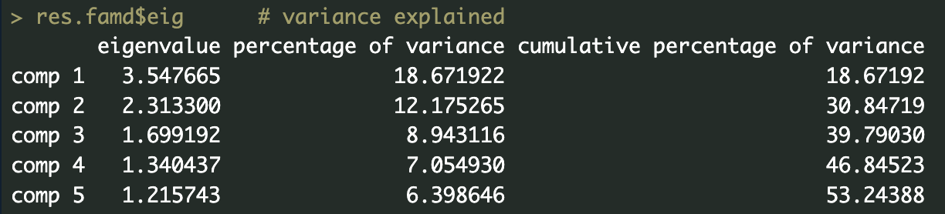
Dimensionality Reduction (1/2)
FAMD (5 dim for 53% var) (not spectacular)
Hierarchical cluster on FAMD dimensions
Dim. 1 = preanti, z30, strat, str2
→ re prior treatment
Dim. 2 = wtkg, age, homo (less so, hemo, gender)
→ lifestyle/physical risks
Dim. 3 = hemo, gender (less so, wtkg, race)
→ physicality/lifestyle risks
Notes:
Reducing dimensionality instead, to find more abstract/underlying subgroups. FAMD which stands for "Factor analysis of mixed data" is PCA but for both categorical and numerical data, which is exactly what we needed. We obtain 5 primary components that describe 53% of variance in our patients' baseline states. To get an idea of what each abstract dimension represents, we see that component 1 correlates with preanti, z30, etc, metrics that increase with prior HIV treatment. 2 represents weight, age, homosexuality, some lifestyle and physical risks. 3 is much the same as 2, we see that they just swap which factors are more strongly and weakly correlated.

Slide 28
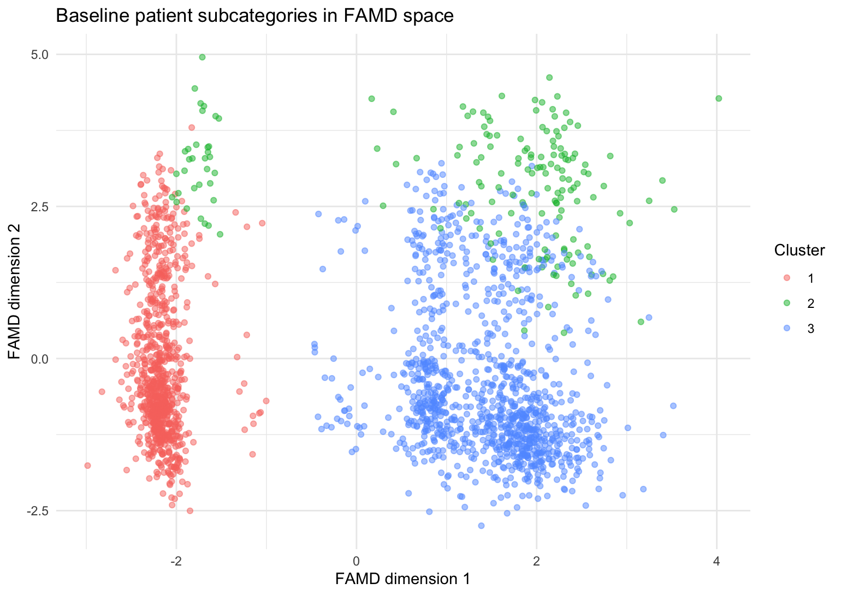
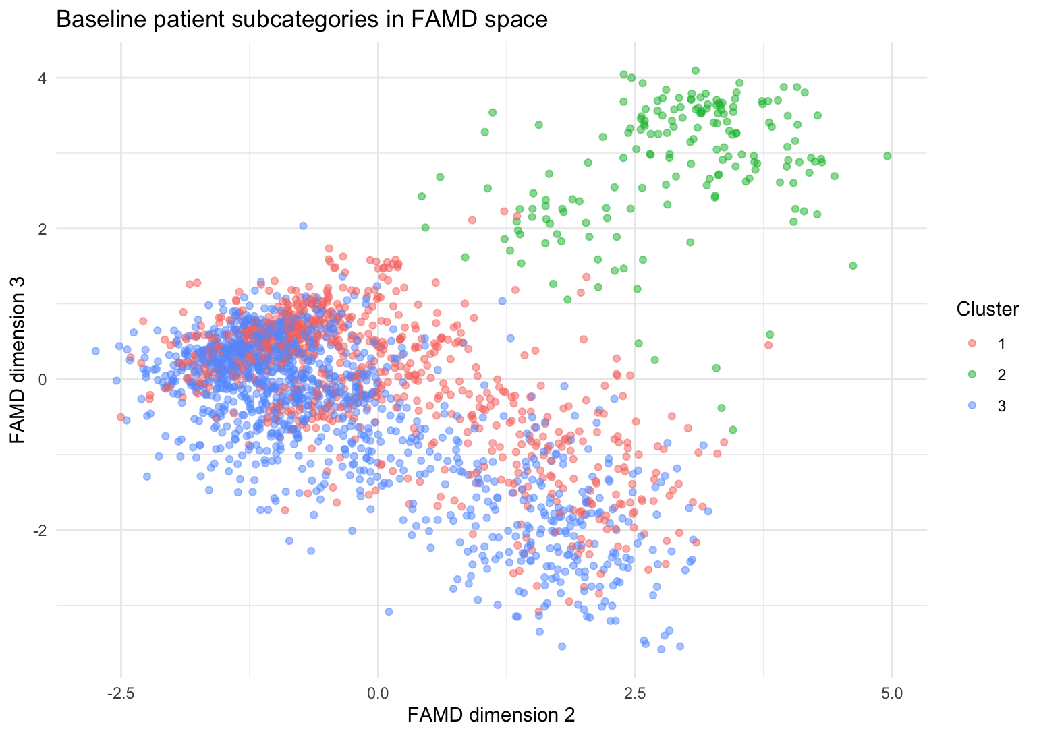
Clustering on Reduced Dimensions (2/2)
counts=
1: 853
2: 177
3: 1109
Dim. 1 = prior treatment (less<-->more)
Dim. 2 = lifestyle (less risk<-->more)
Dim. 3 = physicality (less risk<--more)
Notes:
Doing hierarchical clustering (with default parameters) on those 5 dimensions nets us three primary clusters, our subgroups of patient.
3 clusters with counts 853, 177, and 1109. From our graphs, we may infer that subgroup 2-green, as they score high on both lifestyle and physicality risks, describes those "at high risk for HIV". Then, subgroup 1-red are those treatment-naive, and subgroup 3-blue are the treatment-experienced.

Slide 29
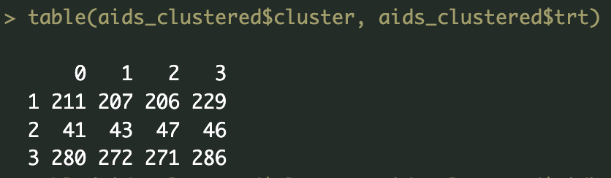
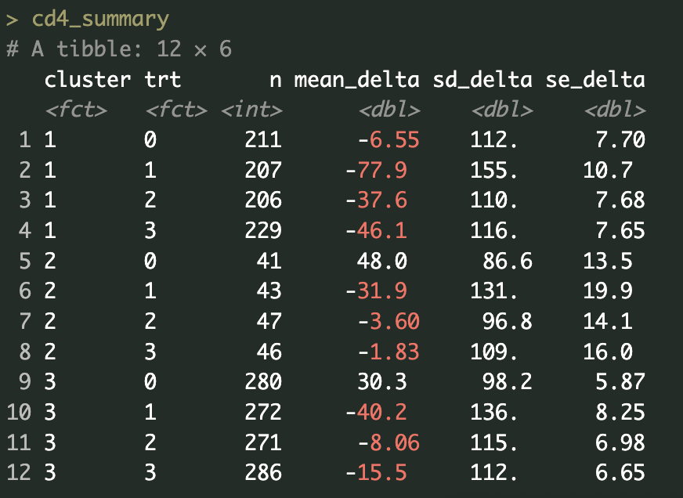
Sanity check
Notes:
We do a quick sanity check to make sure our subgroups are evenly represented in each treatment group. Then, we look at some initial values; we see that the mean efficacy of each treatment vary across subgroups. Still, standard deviation remains quite high, again, more or less par for the course for bio-related data.

Slide 30
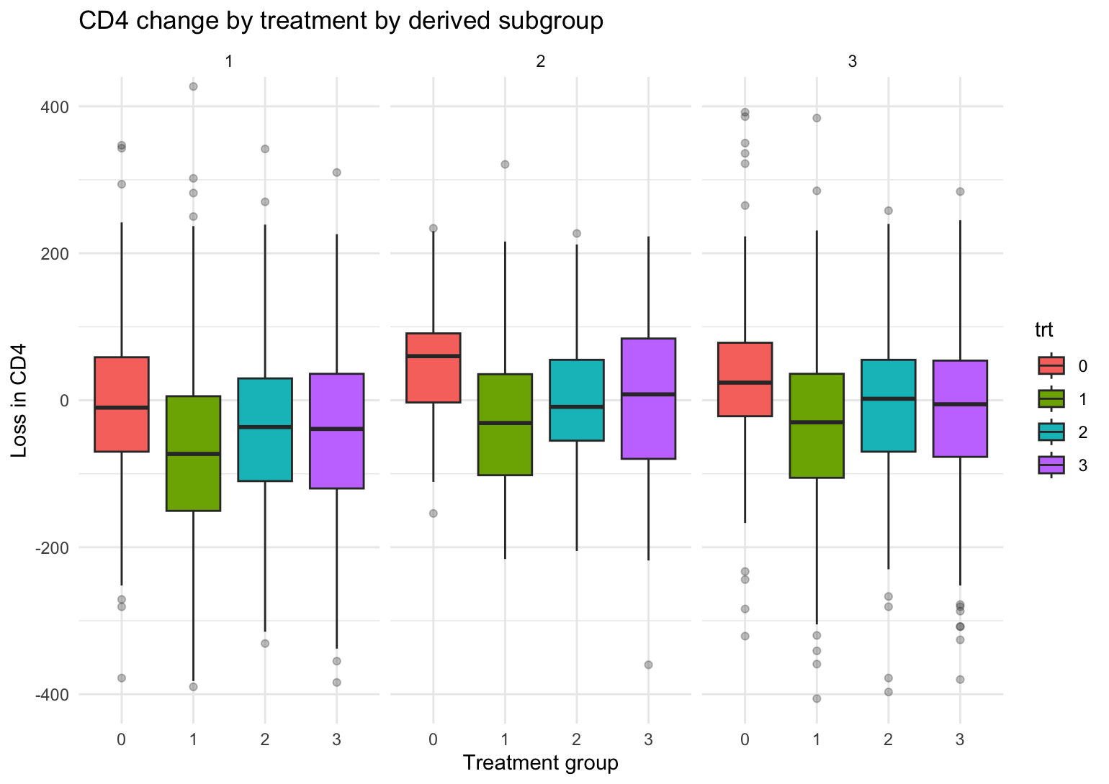
Interpretation
bad
good
Notes:
We plot some boxes to visualise spread better; recall that a high loss in CD4 is bad and negative loss is good. We see that ZDV performs on average the worst of all the study's treatment regimen, on all subgroups, and treatment 1 the best. We see that treatment 2 may be only suitable for subgroup 2, as in subgroups 1 & 3 it performs the same or worse than treatment 3. Of course, the overlap is strong and may not translate to a wider population. Still, note that some individuals may be allergic or otherwise can't take a specific therapy regimen so alternatives that perform the same are important to know about.

Slide 31
Conclusions
What are the subgroups?
Derived subgroups circle around HIV risk
Are there subgroups of patients that would benefit more from a specific therapy?
Probably?
Just not ZDV
Notes:
We derived some subgroups, they mostly are informed by HIV risk/experience (shocker!!!); this would impact how long an individual may have had HIV before the study start, be a specific window into socioeconomic factors, or impact their knowledge about the illness, for example.
So, are there subgroups of patients that would benefit more from a specific therapy? Yes, but the differences are not particularly dramatic and need further investigation as to their in-practice importance. Still, it shows that we should move on from ZDV as the status quo therapy as the others uniformly perform better than it.

Slide 32
06
Conclusion/Future Work

Slide 33
Conclusion/Future Work
Conclusions
ZDV overall less effective than alternative therapies
Numerous predictors showed significant results for death status and the progression of HIV
Future Work
Obtain full dataset that includes temporal data by filing a FOIA request
Examine outliers and expand validation metrics
Include more complex models (time-series analyses or mixed models)
Notes:
Conclusion:
The monotherapy treatment of just Zidovudine, or ZDV, proved to be less effective compared to combination therapies that involved ZDV along with Didanosine or Zalcitabine. Across multiple modeling approaches, several variables consistently emerged as significant predictors for a patient’s outcome or survival status, including symptomatic status, treatment type, if the patient had been on testosterone replacement therapy within the 91-101 weeks before the start of the study, and demographic factors such as age, race, etc. CD4 and CD8 cell counts were consistently determined as significant predictors in most models, which is biologically consistent with their role in the immune system and HIV progression. The restricted dataset access greatly limited our ability to study the progression of immune recovery or decline, which is reflected in the results of our non-linear models that demonstrated low accuracy and explained a small portion of variability.
Future Work:
For future experiments or further research, we could attempt to obtain the full dataset by filing a FOIA (Freedom of Information Act) request in hopes of acquiring temporal data. Additionally, for evaluation improvements, we could more closely examine the influence of outliers in significant variables and expand on validation metrics as well. More complex models can be performed, such as time-series analyses or mixed-effects models to better understand and account for time-to-event outcomes, or the progression of HIV in patients.

